Slide 1
Module 9: Responsible Machine Learning
Notes:
Data scientists and machine learning engineers have an ethical (and often, legal) responsibility to create machine learning models that do not negatively impact individuals or groups of people.
In this module, we'll explore some considerations for responsible machine learning, and some ways in which you can incorporate responsible practices into your machine learning operations.

Slide 2





Agenda
Differential Privacy
Model Interpretability
Fairness
Notes:
Specifically, we'll look at three main areas of responsible machine learning:
- The use of differential privacy to avoid revealing sensitive, personally identifiable data.
- The use of model interpretability to enable transparency in how specific features influence model predictions.
- Considerations for detecting and mitigating unfairness in model predictions for different groups of people.

Slide 3
Differential Privacy
Notes:
Let's first of all look at differential privacy.

Slide 4



The Data Privacy Problem
Studies are ethically and legally required to protect personal information
Repeated analyses of aggregated results can reveal details about individuals
Tech Worker Study (10 Participants)
Average Salary
$96,000
There was one study participant from Seattle, and they earn $96,000
Seattle
New York
San Francisco
Workers per City
10%
New York
Seattle
San Francisco
Notes:
Data science projects, including machine learning projects, involve analysis of data; and often that data includes sensitive personal details that should be kept private.
In practice, most reports that are published from the data include aggregations of the data, which you may think would provide some privacy – after all, the aggregated results do not reveal the individual data values.
However, consider a case where multiple analyses of the data result in reported aggregations that when combined, could be used to work out information about individuals in the source dataset. In the example on the slide, 10 participants share data about their location and salary. The aggregated salary data tells us the average salary in Seattle; and the location data tells us that 10% of the study participants (in other words, a single person) is based in Seattle – so we can easily determine the specific salary of the Seattle-based participant.
Anyone reviewing both studies who happens to know a person from Seattle who participated, now knows that person's salary.

Slide 5
What is Differential Privacy?
The analysis function adds random "noise" to the data
Results are statistically consistent, non-deterministic approximations
Tech Worker Study Participants
Average Salary
$96,874
Each analysis produces slightly different results due to random noise
Results are statistically consistent with true data distribution allowing for random deviation based on probability
Individual contributions to the aggregated values are not identifiable
Seattle
New York
San Francisco
Workers per City
9.6%
New York
Seattle
San Francisco
Notes:
Differential privacy seeks to protect individual data values by adding statistical "noise" to the analysis process. The math involved in adding the noise is quite complex, but the principle is fairly intuitive – the noise ensures that data aggregations stay statistically consistent with the actual data values allowing for some random variation, but make it impossible to work out the individual values from the aggregated data. In addition, the noise is different for each analysis, so the results are non-deterministic – in other words, two analyses that perform the same aggregation may produce slightly different results.

Slide 6
Epsilon - The Privacy Loss Parameter
To minimize risk of personal identification, an individual could opt out of a study
To be effective for all individuals, they would all need to opt out - so the study would be useless
Differential privacy adds noise so the maximum impact of an individual on the outcome of an aggregative analysis is at most epsilon (ϵ)
The incremental privacy risk between opting out vs participation for any individual is governed by ϵ
Lower ϵ values result in greater privacy but lower accuracy
Higher ϵ values result in greater accuracy with higher risk of individual identification
Privacy
ϵ
Accuracy
Notes:
One way that an individual can protect their personal data is simply to not participate in a study – this is known as their "opt-out" option. However, there are a few considerations for this as a solution:
Even if you opt-out a study may still produce results that affect you. For example, you may choose to opt-out of a study that compares the heart disease diagnoses across a group of people on the basis that doing so may reveal a heart disease diagnosis that causes your health insurance premiums to rise. If the study finds a correlation between people who drink coffee and higher risk of heart disease, and your insurance company knows that you are a coffee drinker, your rate may rise even though you didn’t personally participate in the study.
The benefits of participation in the study may outweigh any negative impact. For example, if you're paid $100 to participate in a study that results in your health insurance rate rising by $10 per year, it will be more than ten years before you make a net loss. This may be a worthwhile tradeoff to you (particularly if your rate may rise as a result of the study even if you don’t participate!)
The only way for the opt-out option to work for every individual, is for every individual not to take part – which makes the whole study pretty pointless!
The amount of variation caused by adding noise is configurable through a parameter called epsilon. This value governs the amount of additional risk that your personal data can be identified through rejecting the opt-out option and participating in a study. The key thing is that it applies this privacy principle for everyone participating in the study. A low epsilon value provides the most privacy, at the expense of less accuracy when aggregating the data. A higher epsilon value results in aggregations that are more true to the actual data distribution, but in which the individual contribution of a single individual to the aggregated value is less obscured by noise.

Slide 7

Lab: Explore Differential Privacy
View the lab instructions at https://aka.ms/mslearn-dp100
Complete the Explore differential privacy exercise
Notes:
Students can complete the lab using only a browser and the Azure subscription they created previously. The lab instructions are at the address on the slide.
Alternatively, if students are using a hosted environment to complete the lab, get them to start it and find ther appropriate exercise instructions..

Slide 8
Model Interpretability
Notes:
One of the key principles of responsible machine learning is transparency. You should, as much as possible, be able to explain why a model makes the predictions that it does.

Slide 9
Model Interpretability in Azure Machine Learning
Statistical explanation of feature importance
Quantifies the influence of each feature on prediction
Important to identify bias or unintended correlation in the model
Based on the Open Source Interpret-Community package
Includes explainers based on common model interpretation algorithms like:
Shapely Additive Explanations (SHAP)
Local Interpretable Model-Agnostic Explanations (LIME)
Notes:
The range of machine learning algorithm types and the nature of how machine learning model training works make this a hard problem to solve, but model interpretability has become a key element of helping to make model predictions explainable.
Model interpretability in Azure Machine Learning is based on the open source **Interpret-Community** package, which is itself a wrapper around a collection of *explainers* based on proven and emerging model interpretation algorithms, such as Shapely Additive Explanations (SHAP) (https://github.com/slundberg/shap) and Local Interpretable Model-agnostic Explanations (LIME) (https://github.com/marcotcr/lime).

Slide 10
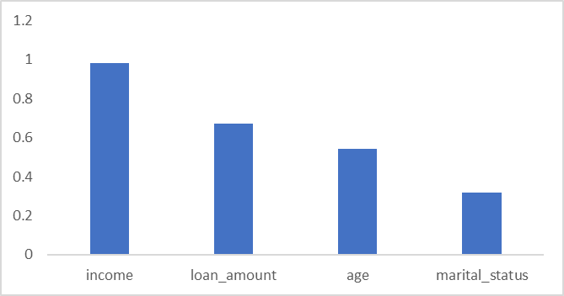
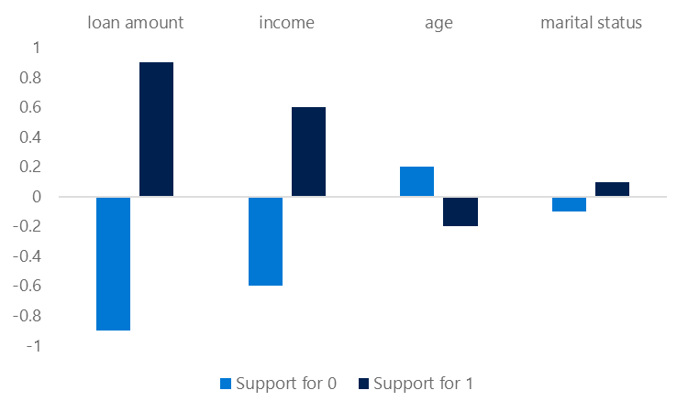
Global and Local Feature Importance
Global Feature Importance
Overall feature importance for all test data
Indicates the relative influence of each feature on the predicted label
Local Feature Importance
Feature importance for an individual prediction
In classification, this shows the relative support for each possible class per feature
Notes:
Model explainers use statistical techniques to calculate *feature importance*. This enables you to quantify the relative influence each feature in the training dataset has on label prediction. Explainers work by evaluating a test data set of feature cases and the labels the model predicts for them.
Global feature importance
Global feature importance quantifies the relative importance of each feature in the test dataset as a whole. It provides a general comparison of the extent to which each feature in the dataset influences prediction. For example, a binary classification model to predict loan default risk might be trained from features such as loan amount, income, marital status, and age to predict a label of 1 for loans that are likely to be repaid, and 0 for loans that have a significant risk of default (and therefore shouldn't be approved). An explainer might then use a sufficiently representative test dataset to produce the following global feature importance values: - income: 0.98
- loan amount: 0.67
- age: 0.54
- marital status: 0.32
It's clear from these values, that in respect to the overall predictions generated by the model for the test dataset, income is the most important feature for predicting whether or not a borrower will default on a loan, followed by the loan amount, then age, and finally marital status.
Local feature importance
Local feature importance measures the influence of each feature value for a specific individual prediction. For example, suppose Sam applies for a loan, which the machine learning model approves (by predicting that Sam won't default on the loan repayment). You could use an explainer to calculate the local feature importance for Sam's application to determine which factors influenced the prediction. You might get a result like this:
Feature Support for 0 Support for 1
loan amount -0.9 0.9
income -0.6 0.6
age 0.2 -0.2
marital status -0.1 0.1
Because this is a classification* model, each feature gets a local importance value for each possible class, indicating the amount of support for that class based on the feature value. Since this is a binary classification model, there are only two possible classes (0 and 1). Each feature's support for one class results in correlatively negative level of support for the other.
In Sam's case, the overall support for class 0 is -1.4, and the support for class 1 is correspondingly 1.4; so support for class 1 is higher than for class 0, and the loan is approved. The most important feature for a prediction of class 1 is loan amount, followed by income - these are the opposite order from their global feature importance values (which indicate that income is the most important factor for the data sample as a whole). There could be multiple reasons why local importance for an individual prediction varies from global importance for the overall dataset; for example, Sam might have a lower income than average, but the loan amount in this case might be unusually small.
For a multi-class classification model, a local importance values for each possible class is calculated for every feature, with the total across all classes always being 0. For example, a model might predict the species of a penguin based on features like its bill length, bill width, flipper length, and weight. Suppose there are three species of penguin, so the model predicts one of three class labels (0, 1, or 2). For an individual prediction, the flipper length feature might have local importance values of 0.5 for class 0, 0.3 for class 1, and -0.8 for class 2 - indicating that the flipper length moderately supports a prediction of class 0, slightly supports a prediction of class 1, and strongly supports a prediction that this particular penguin is not class 2.
For a regression model, there are no classes so the local importance values simply indicate the level of influence each feature has on the predicted scalar label.

Slide 11
Explainers
Use the azureml-interpret package
Create an explainer:
MimicExplainer – global surrogate model that approximates your model
TabularExplainer – Invokes direct SHAP explainer based on model architecture
PFIExplainer – Permutation Feature Importance based on feature shuffling
Get global or local feature explanations
from interpret.ext.blackbox import TabularExplainer
tab_explainer = TabularExplainer(model, X_train, features=features, classes=labels)
global_explanation = tab_explainer.explain_global(X_train)
Notes:
You can use the Azure Machine Learning SDK to create explainers for models, even if they were not trained using an Azure Machine Learning experiment.
To interpret a model, you must install the azureml-interpret package and use it to create an explainer. There are multiple types of explainer, including:
- MimicExplainer - An explainer that creates a global surrogate model that approximates your trained model and can be used to generate explanations. This explainable model must have the same kind of architecture as your trained model (for example, linear or tree-based).
- TabularExplainer - An explainer that acts as a wrapper around various SHAP explainer algorithms, automatically choosing the one that is most appropriate for your model architecture.
- PFIExplainer - a Permutation Feature Importance explainer that analyzes feature importance by shuffling feature values and measuring the impact on prediction performance.
To retrieve global importance values for the features in your model, you call the explain_global() method of your explainer to get a global explanation, and then use the get_feature_importance_dict() method to get a dictionary of the feature importance values.
To retrieve local feature importance from a MimicExplainer or a TabularExplainer, you must call the explain_local() method of your explainer, specifying the subset of cases you want to explain. Then you can use the get_ranked_local_names() and get_ranked_local_values() methods to retrieve dictionaries of the feature names and importance values, ranked by importance.

Slide 12
Adding Explanations to Training Experiments
In the training script, import the ExplanationClient class
Generate explanations and upload them to the run
Use ExplanationClient to download explanations
explain_client = ExplanationClient.from_run(run)
explainer = MimicExplainer(model, X_train, LinearExplainableModel,
features=features, classes=labels)
explanation = explainer.explain_global(X_test)
explain_client.upload_model_explanation(explanation, comment='Model Explanation')
from azureml.interpret.explanation_client import ExplanationClient
client = ExplanationClient.from_run_id(workspace=ws,
experiment_name=experiment.experiment_name,
run_id=run.id)
explanation = client.download_model_explanation()
Notes:
When you use an estimator or a script to train a model in an Azure Machine Learning experiment, you can create an explainer and upload the explanation it generates to the run for later analysis.
To create an explanation in the experiment script, you'll need to ensure that the azureml-interpret package is installed in the run environment. Then you can use these to create an explanation from your trained model and upload it to the run outputs.
You can view the explanation you created for your model in the Explanations tab for the run in Azure Machine learning studio. You can also use the ExplanationClient object to download the explanation in Python.

Slide 13
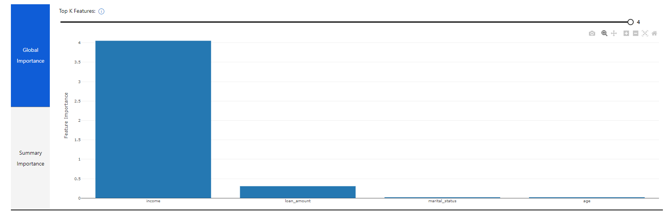
Visualizing Model Explanations
View the Explanations tab for the run in Azure Machine Learning studio
Notes:
Model explanations in Azure Machine Learning studio include multiple visualizations that you can use to explore feature importance. Visualizations are only available for experiment runs that were configured to generate and upload explanations. When using automated machine learning, only the run producing the best model has explanations generated by default.
The first visualization on the Explanations tab for a run shows global feature importance.
Switching to the Summary Importance visualization shows the distribution of individual importance values for each feature across the test dataset.
Selecting an individual data point shows the local feature importance for the case to which the data point belongs.

Slide 14
Interpretability During Inferencing
Register a lightweight scoring explainer with the model
Use the model and the explainer in the service scoring script
Deploy a service with the model and explainer
scoring_explainer = KernelScoringExplainer(explainer)
save(scoring_explainer, directory='dir', exist_ok=True)
Model.register(ws, model_name='model', model_path='dir/model.pkl')
Model.register(ws, model_name='explainer', model_path='dir/scoring_explainer.pkl')
def run(raw_data):
data = json.loads(raw_data)['data']
predictions = model.predict(data)
local_importance_values = explainer.explain(data)
return {"predictions":predictions.tolist()), "importance":local_importance_values}
service = Model.deploy(ws, 'classify_svc', [model, explainer], inf_config, dep_config)
Notes:
In some scenarios, you might want to generate explanations along with predictions from a published model.
The first step in this process is to create a scoring explainer*as a wrapper for your model explainer, and register it in the same workspace as your model.
After registering the explainer, you can create a scoring script for a real-time service that loads the explainer and uses it to return explanations along with predictions.
With the scoring script created, you can deploy the service - referencing both the predictive model and the explainer.
When you consume the service, the JSON returned includes both the predictions and the associated local feature importance values:
{
'predictions': [1],
'local_importance': [[[-0.12, -0.15, -0.03, 0.11]],
[[0.12, 0.15, 0.03, -0.11]]]
}

Slide 15
Lab: Interpret Models
View the lab instructions at https://aka.ms/mslearn-dp100
Complete the Interpret models exercise
Notes:
Students can complete the lab using only a browser and the Azure subscription they created previously. The lab instructions are at the address on the slide.
Alternatively, if students are using a hosted environment to complete the lab, get them to start it and find ther appropriate exercise instructions..

Slide 16
Fairness
Notes:
Machine learning models can often encapsulate unintentional bias that results in unfairness. With Fairlearn and Azure Machine Learning, you can detect and mitigate unfairness in your models.

Slide 17





What is Fairness?
Absence of negative impact on groups based on:
Ethnicity
Gender
Age
Physical disability
other sensitive features
Notes:
Machine learning models are increasingly used to inform decisions that affect peoples lives. For example, prediction made by a machine learning model might influence:
- Approval for a loan, insurance, or other financial service.
- Acceptance into a school or college course.
- Eligibility for a medical trial or experimental treatment.
- Inclusion in a marketing promotion.
- Selection for employment or promotion.
With such critical decisions in the balance, it's important to have confidence that the machine learning models we rely on predict fairly, and don't discriminate for or against subsets of the population based on ethnicity, gender, age, or other factors.

Slide 18







Evaluating Model Fairness
Example: Loan repayment binary classification for two age groups
Selection Rate Disparity Prediction Performance Disparity
<=25
>25
<=25
>25
Overall selection rate = 10/22 (45%)
25 & under selection rate = 4/11 (36%)
Over 25 selection rate = 6/11 (54%)
Disparity = 18%
Overall recall = 8/12 (67%)
25 & under recall = 3/6 (50%)
Over 25 recall = 5/6 (83%)
Disparity = 33%
Notes:
Suppose a classification model is used to predict the probability of a successful loan repayment, and therefore influences whether or not the loan is approved. It's likely that the model will be trained using features that reflect characteristics of the applicant, such as:
- Age
- Employment status
- Income
- Savings
- Current debt
These features are used to train a binary classification model that predicts whether an applicant will repay a loan.
Suppose the model predicts that around 45% of applicants will successfully repay their loans. However, on reviewing loan approval records, you begin to suspect that that fewer loans are approved for applicants aged 25 or younger than for applicants who are over 25. How can you be sure the model is fair to applicants in both age groups?
Selection rate disparity
One way to start evaluating the fairness of a model is to compare predictions for each group within a sensitive feature. For the loan approval model, Age is a sensitive feature that we care about, so we could split the data into subsets for each age group and compare the selection rate (the proportion of positive predictions) for each group.
Let's say we find that the model predicts that 36% of applicants aged 25 or younger will repay a loan, but it predicts successful repayments for 54% of applicants aged over 25. There's a disparity in predictions of 18%.
At first glance, this comparison seems to confirm that there's bias in the model that discriminates against younger applicants. However, when you consider the population as a whole, it may be that younger people generally earn less than people more established in their careers, have lower levels of savings and assets, and have a higher rate of defaulting on loans.
The important point to consider here is that just because we want to ensure fairness in regard to age, it doesn't necessarily follow that age is not a factor in loan repayment probability. It's possible that in general, younger people really are less likely to repay a loan than older people. To get the full picture, we need to look a little deeper into the predictive performance of the model for each subset of the population.
Prediction performance disparity
When you train a machine learning model using a supervised technique, like regression or classification, you use metrics achieved against hold-out validation data to evaluate the overall predictive performance of the model. For example, you might evaluate a classification model based on accuracy, precision, or recall.
To evaluate the fairness of a model, you can apply the same predictive performance metric to subsets of the data, based on the sensitive features on which your population is grouped, and measure the disparity in those metrics across the subgroups.
For example, suppose the loan approval model exhibits an overall recall metric of 0.67 - in other words, it correctly identifies 67% of cases where the applicant repaid the loan. The question is whether or not the model provides a similar rate of correct predictions for different age groups.
To find out, we group the data based on the sensitive feature (Age) and measure the predictive performance metric (recall) for those groups. Then we can compare the metric scores to determine the disparity between them.
Let's say that we find that the recall for validation cases where the applicant is 25 or younger is 0.50, and recall for cases where the applicant is over 25 is 0.83. In other words, the model correctly identified 50% of the people in the 25 or younger age group who successfully repaid a loan (and therefore misclassified 50% of them as loan defaulters), but found 83% of loan repayers in the older age group (misclassifying only 17% of them). The disparity in prediction performance between the groups is 33%, with the model predicting significantly more false negatives for the younger age group.

Slide 19
Mitigating Unfairness
Create models with parity constraints:
Demographic parity: Minimize disparity in the selection rate across sensitive feature groups.
True positive rate parity: Minimize disparity in true positive rate across sensitive feature groups
False positive rate parity: Minimize disparity in false positive rate across sensitive feature groups
Equalized odds: Minimize disparity in combined true positive rate and false positive rate across sensitive feature groups
Error rate parity: Ensure that the error for each sensitive feature group does not deviate from the overall error rate by more than a specified amount
Bounded group loss: Restrict the loss for each sensitive feature group in a regression model
Notes:
A common approach to mitigation is to use one of the algorithms and constraints to train multiple models, and then compare their performance, selection rate, and disparity metrics to find the optimal model for your needs. Often, the choice of model involves a trade-off between raw predictive performance and fairness - based on your definition of fairness for a given scenario. Generally, fairness is measured by reduction in disparity of feature selection (for example, ensuring that an equal proportion of members from each gender group is approved for a bank loan) or by a reduction in disparity of performance metric (for example, ensuring that a model is equally accurate at identifying repayers and defaulters in each age group).
To train the models for comparison, you use mitigation algorithms to create alternative models that apply parity constraints to produce comparable metrics across sensitive feature groups. The following list describes some common algorithms used to optimize models for fairness. - Exponentiated Gradient - A *reduction* technique that applies a cost-minimization approach to learning the optimal trade-off of overall predictive performance and fairness disparity (Binary classification and regression)
- Grid Search - A simplified version of the Exponentiated Gradient algorithm that works efficiently with small numbers of constraints (Binary classification and regression)
- Threshold Optimizer - A *post-processing* technique that applies a constraint to an existing classifier, transforming the prediction as appropriate (Binary classification)
The choice of parity constraint depends on the technique being used and the specific fairness criteria you want to apply. Constraints include: - Demographic parity: Use this constraint with any of the mitigation algorithms to minimize disparity in the selection rate across sensitive feature groups. For example, in a binary classification scenario, this constraint tries to ensure that an equal number of positive predictions are made in each group.
- True positive rate parity: Use this constraint with any of the mitigation algorithms to minimize disparity in *true positive rate* across sensitive feature groups. For example, in a binary classification scenario, this constraint tries to ensure that each group contains a comparable ratio of true positive predictions.
- False positive rate parity: Use this constraint with any of the mitigation algorithms to minimize disparity in *false positive rate* across sensitive feature groups. For example, in a binary classification scenario, this constraint tries to ensure that each group contains a comparable ratio of false positive predictions.
- Equalized odds: Use this constraint with any of the mitigation algorithms to minimize disparity in combined *true positive rate* and *false positive rate* across sensitive feature groups. For example, in a binary classification scenario, this constraint tries to ensure that each group contains a comparable ratio of true positive and false positive predictions.
- Error rate parity: Use this constraint with any of the reduction-based mitigation algorithms (Exponentiated Gradient and Grid Search) to ensure that the error for each sensitive feature group does not deviate from the overall error rate by more than a specified amount.
- Bounded group loss: Use this constraint with any of the reduction-based mitigation algorithms to restrict the loss for each sensitive feature group in a *regression* model.

Slide 20
Lab: Detect and Mitigate Unfairness
View the lab instructions at https://aka.ms/mslearn-dp100
Complete the Detect and mitigate unfairness exercise
Notes:
Students can complete the lab using only a browser and the Azure subscription they created previously. The lab instructions are at the address on the slide.
Alternatively, if students are using a hosted environment to complete the lab, get them to start it and find ther appropriate exercise instructions..

Slide 21

Knowledge check
In a differential privacy solution, what is the effect of setting an epsilon parameter?
A lower epsilon reduces the impact of an individual's data on aggregated results, increasing privacy and decreasing accuracy
A lower epsilon reduces the amount of noise added to the data, increasing accuracy and decreasing privacy
You have trained a model, and you want to quantify the influence of each feature on a specific individual prediction. What kind of feature importance should you examine?
Global feature importance
Local feature importance
You are training a binary classification model to support admission approval decisions for a college degree program.
How can you evaluate if the model is fair, and doesn't discriminate based on ethnicity?
Evaluate each trained model with a validation dataset and use the model with the highest accuracy score.
Remove the ethnicity feature from the training dataset.
Compare disparity between selection rates and performance metrics across ethnicities.
Notes:
Use the slide animations to reveal the correct answers.

Slide 22
References
Microsoft Learn: Explore differential privacy
https://docs.microsoft.com/learn/modules/explore-differential-privacy
Microsoft Learn: Explain machine learning models with Azure Machine Learning
https://docs.microsoft.com/learn/modules/explain-machine-learning-models-with-azure-machine-learning
Microsoft Learn: Detect and mitigate unfairness in models with Azure Machine Learning
https://docs.microsoft.com/learn/modules/detect-mitigate-unfairness-models-with-azure-machine-learning
Azure Machine Learning responsible ML documentation
https://docs.microsoft.com/azure/machine-learning/concept-responsible-ml
Notes:
Use the references on the slide to learn more. In particular, note the online learning modules on Microsoft Learn that are related to the material covered in this module.

Slide 23
Closing slide

